Slide 1

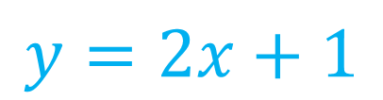


Algebra Interactive Notebook
$$3ab$$
$$\frac{5xy}{6}$$
Name :
Class :
Term 1 Semester 1
$$2x+3y$$
$$y=2x+1$$

Slide 2
Contents
Glossary
Page
Date
Description
2
3

Slide 3
Tasks
24
7
30
Essential Question
Questions
Notes
Summary
4
7

Slide 4
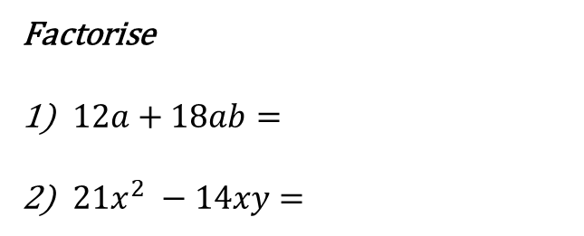

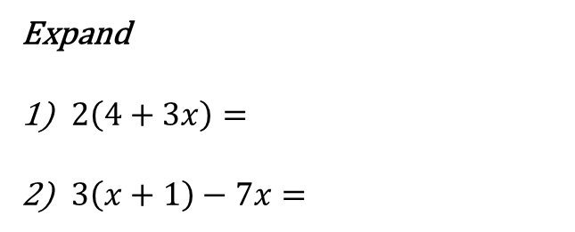
revision
Simplify
$5y−x+2y=$
$−4a ×2ab=$
$\frac{21a^{2}b}{3abc}=$
Expand
$2\left(4+3x\right)=$
$3\left(x+1\right)−7x=$
Factorise
$12a+18ab=$
$21x^{2} −14xy=$

Slide 5
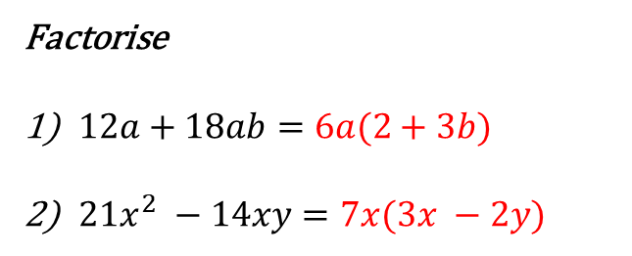
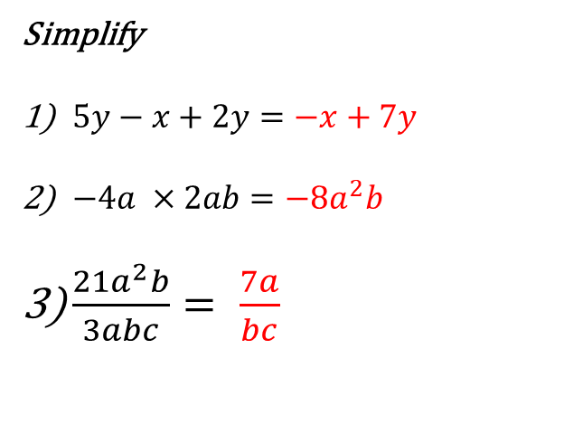
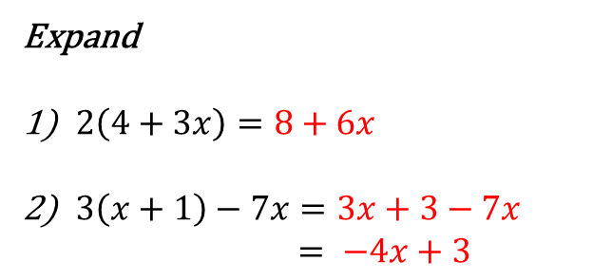
revision
Simplify
$5y−x+2y=−x+7y$
$−4a ×2ab=−8a^{2}b$
$\frac{21a^{2}b}{3abc}= \frac{7a}{bc}$
Expand
$2\left(4+3x\right)=8+6x$
$3\left(x+1\right)−7x=3x+3−7x$
$= −4x+3$
Factorise
$12a+18ab=6a(2+3b)$
$21x^{2} −14xy=7x(3x −2y)$

Slide 6
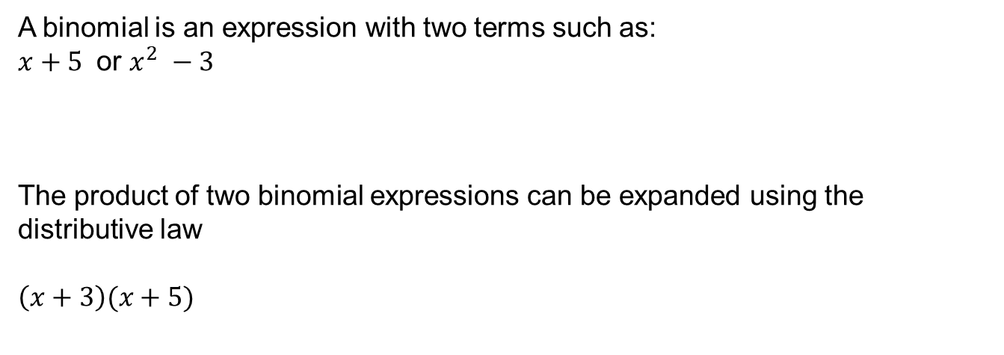
Expanding binomials
24
7
30
EQ: How do I expand binomial products?
What is a binomial?
A binomial is an expression with two terms such as:
$x+5$ or $x^{2} −3$
The product of two binomial expressions can be expanded using the distributive law
$\left(x+3\right)(x+5)$
How do I expand binomials?

Slide 7
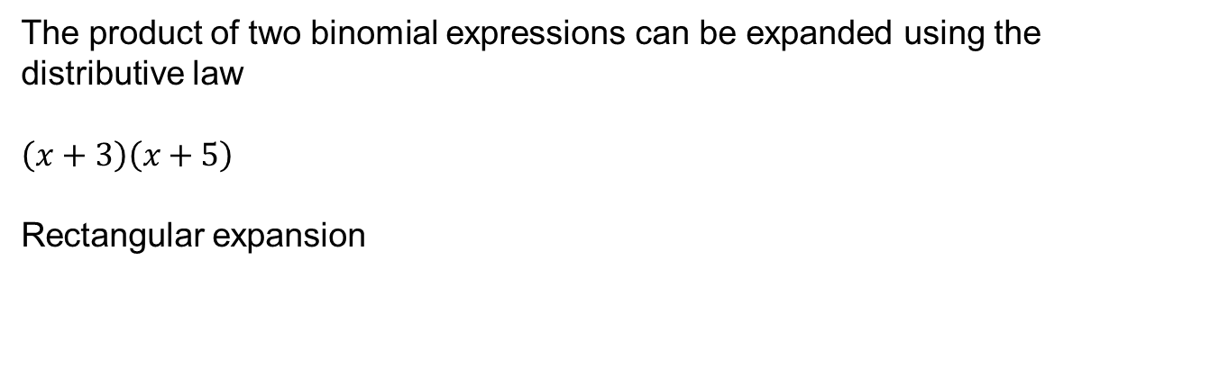
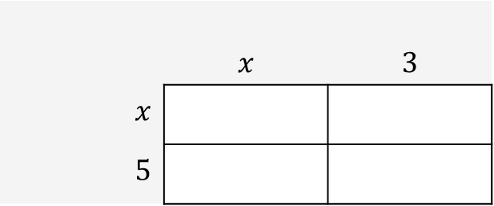
Expanding binomials
24
7
30
EQ: How do I expand binomial products?
How do I expand binomials?
The product of two binomial expressions can be expanded using the distributive law
$\left(x+3\right)\left(x+5\right)$
Rectangular expansion
 | $$x$$ | $$3$$
$x$
$5$

Slide 8
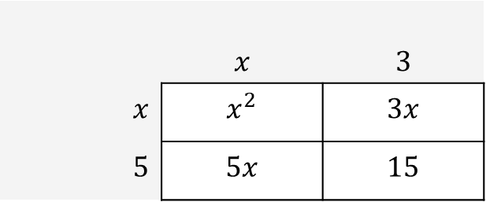

Expanding binomials
24
7
30
EQ: How do I expand binomial products?
How do I expand binomials?
The product of two binomial expressions can be expanded using the distributive law
$\left(x+3\right)\left(x+5\right)$
Rectangular expansion
 | $$x$$ | $$3$$
$x$ | $$x^{2}$$ | $$3x$$
$5$ | $$5x$$ | $$15$$
$= x^{2}+3x+5x+15$
$= x^{2}+8x+15$

Slide 9
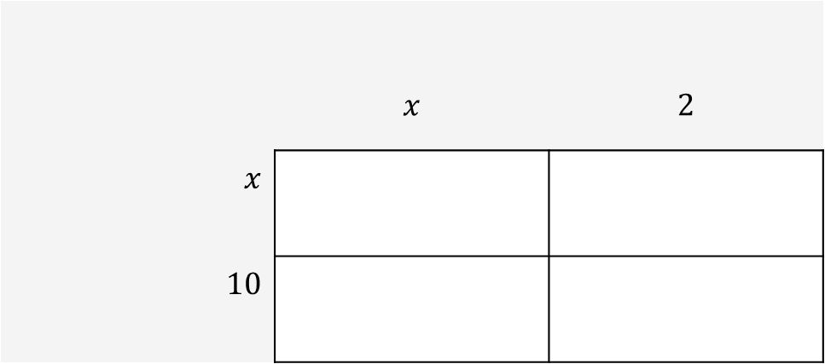

WE do
$$(x+2)(x+10)$$
 | $$x$$ | $$2$$
$x$
$10$

Slide 10

you do
$$(x+5)(x+7)$$

Slide 11
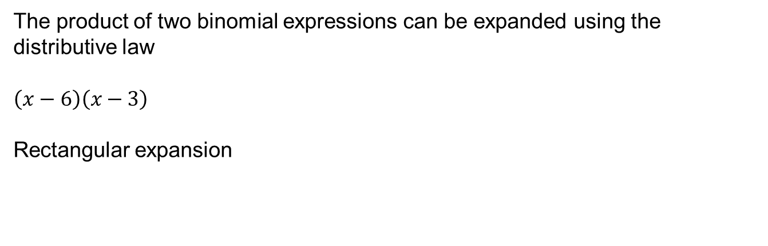
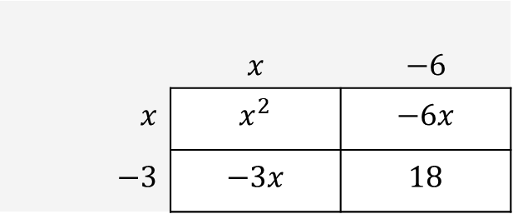

Expanding binomials
24
7
30
EQ: How do I expand binomial products?
How do I expand binomials?
The product of two binomial expressions can be expanded using the distributive law
$\left(x−6\right)\left(x−3\right)$
Rectangular expansion
 | $$x$$ | $$−6$$
$x$ | $$x^{2}$$ | $$−6x$$
$−3$ | $$−3x$$ | $$18$$
$= x^{2}−6x−3x−18$
$= x^{2}−9x−18$

Slide 12
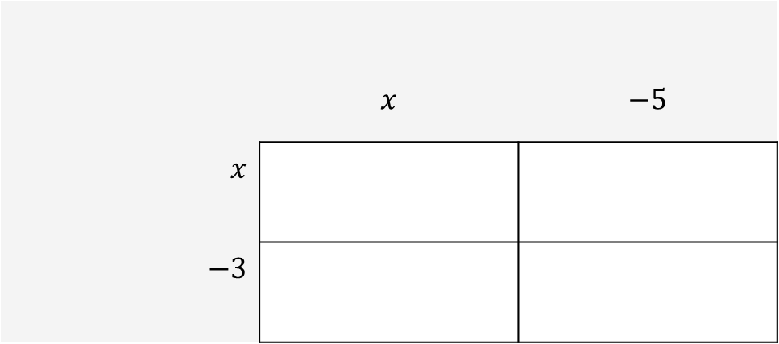

WE do
$$(x−5)(x−3)$$
 | $$x$$ | $$−5$$
$x$
$−3$

Slide 13

you do
$$(x−10)(x−2)$$

Slide 14





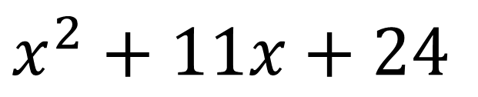




Another way?
$$×$$
$$×$$
$\left(x+3\right) \left(x+8\right)$
$$×$$
$$×$$
$x^{2}$
$$+ 8x$$
$$+ 3x$$
$$+ 24$$
$x^{2}+11x+24$

Slide 15



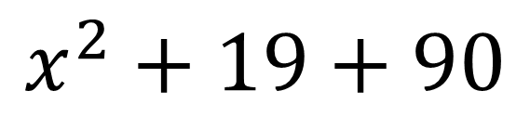

Another way?
$$×$$
$$×$$
$\left(x+9\right) \left(x+10\right)$
$$×$$
$$×$$
$x^{2}$
$$+ 10x$$
$$+ 9x$$
$$+ 90$$
$$x^{2}+19+90$$

Slide 16
Questions:
Essential Mathematics
Page 449

